Slide 1
Extending AES to 192- and 256- bits
By
Dixita Sharegar
Saranya Radhakrishnan

Slide 2
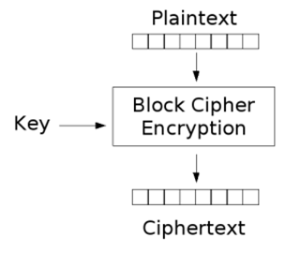
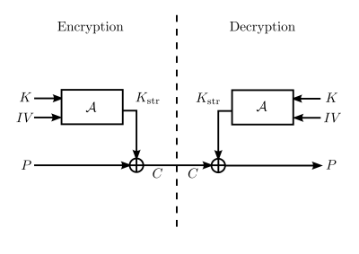
Advanced Encryption Standard (Aes)
Symmetric block cipher

Slide 3
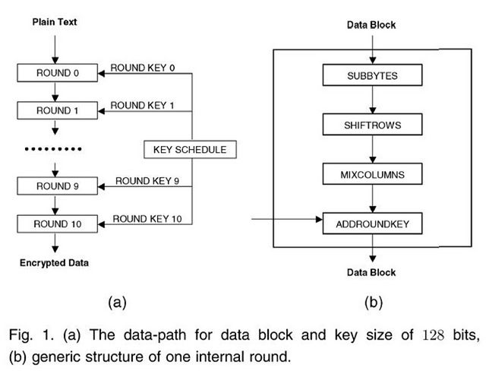
ENCRYPTION

Slide 4
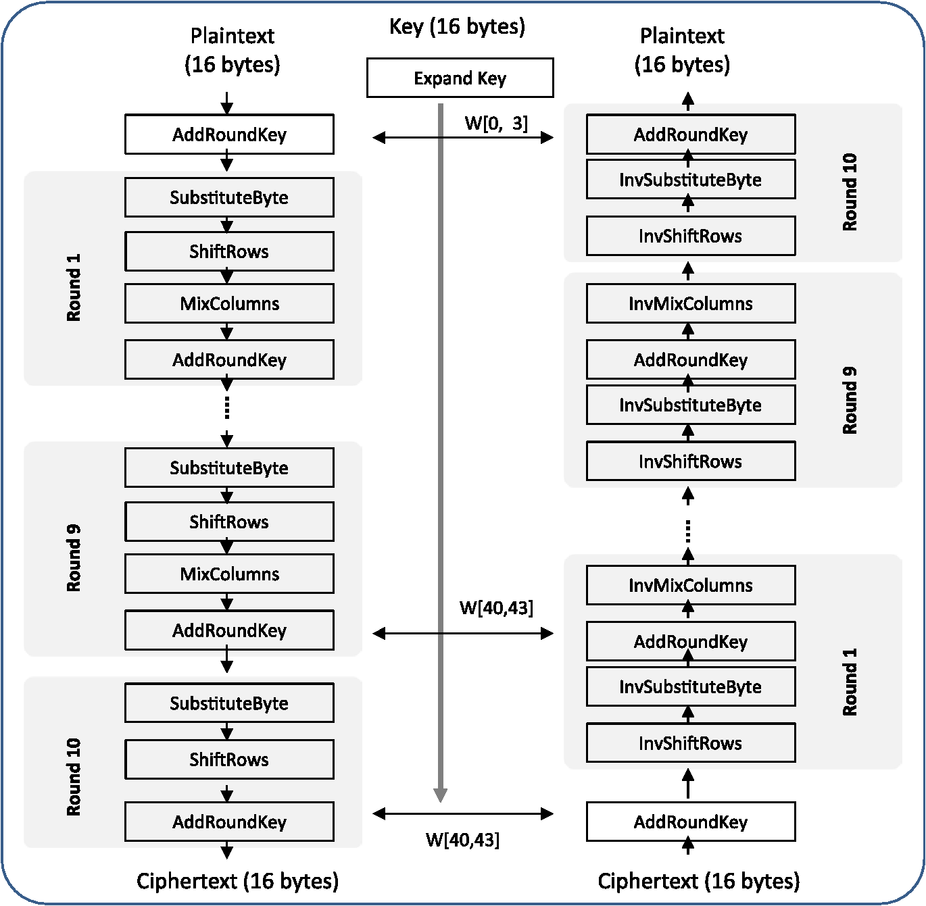
DECRYPTION

Slide 5
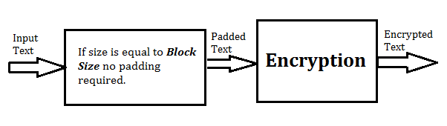
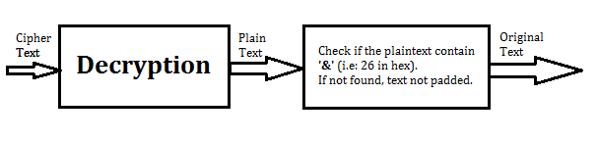
PADDING
If InputSize == BlockSize

Slide 6
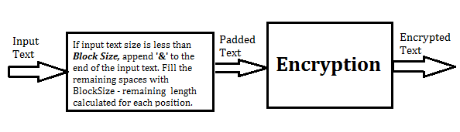
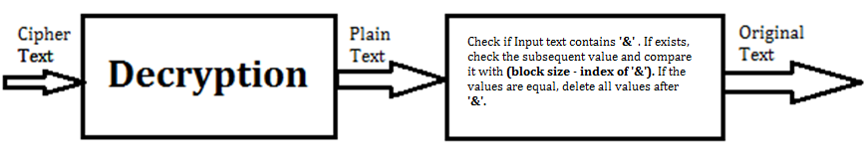
PADDING
If InputSize < BlockSize

Slide 7
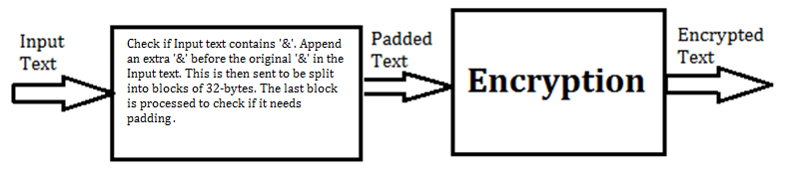
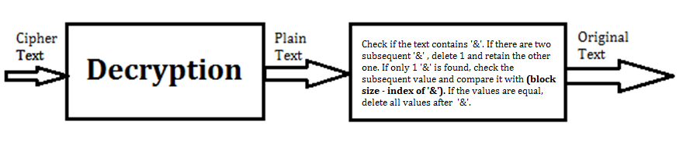
PADDING
If InputSize > BlockSize

Slide 8
demo
Open Code Location For Demo

Slide 9
Authentication technique
HMAC-SHA-3
HMAC is fast and secure
SHA-3 provides high level of parallelism and is fast.
New and has not yet been broken

Slide 10


Slide 11


Slide 12
REFERENCES
Block Cipher Image
Symmetric Block Cipher Image
Encryption Steps Image
Decryption Steps Image
Q & A Image
Encryption & Decryption Algorithm Paper
Thank You Image

